Slide 1



Analysis of 2019 Lok Sabha Elections
Data Analysis
Prepared By :
Name : Aarsh Sevak
Roll no : 162
Batch : B5
Branch : CSE
Enrollment No : 21002171210150

Slide 2
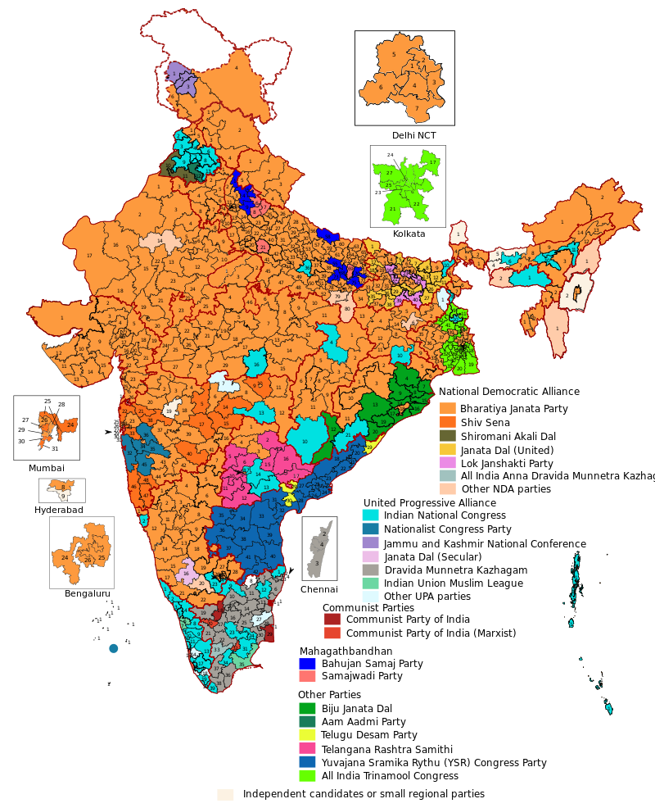
Introduction to Lok Sabha :
The Lok Sabha, or House of the People, is the lower house of India’s bicameral Parliament, with the upper house being the Rajya Sabha.
Members of the Lok Sabha are elected by an adult universal suffrage and a first-past-the-post system to represent their respective constituencies, and they hold their seats for five years or until the body is dissolved by the President on the advice of the council of ministers.
The house meets in the Lok Sabha Chambers of the Sansad Bhavan, New Delhi.
The maximum membership of the House allotted by the Constitution of India is 552 (Initially, in 1950, it was 500).
Currently, the house has 543 seats which are made up by the election of up to 543 elected members and at a maximum. Between 1952 and 2020, 2 additional members of the Anglo-Indian community were also nominated by the President of India on the advice of the Government of India, which was abolished in January 2020 by the 104th Constitutional Amendment Act, 2019.
The Lok Sabha has a seating capacity of 550.

Slide 3
WHY TO ANALYSE THIS DATASET?
The purpose of this dataset is to gain meaningful insights from raw data to support decision-making, identify patterns, and extract valuable information.
In this dataset every single information is given about the candidates i.e. caste,education,gender,crime record,party they belong ,votes they received, all information is given
By analyzing the data we can predict what can be the future results of the candidate as well as the party’s future is predicted as they can win 2024’s election or not .
We can say that BJP has taken over as its members has highest seats in Lok Sabha. It can be seen that in 2024’s Election the Exit Poll will be in favour of BJP party

Slide 4
HOW LOK SABHA 2019 DATA HAS BEEN ANALYSED ?
The data has been cleaned and null values have been removed there were around 245 null values which would have deceased our analysis .
The analysis is done by creating the groups and the data is analyzed based on :
Graphs have been created to visualize the data in more enhancive way.
CASTE
AGE
EDUCATION
CRIMINAL RECORDS
GENDER
PARTY

Slide 5

GRAPHS :
Candidate’s Education
Criminal Counts in the State
Crime v/s Education
Male Female ratio in candidates
Caste based discrimination b/w candidates
Party wise candidates allocations
Party candidates crime cases
State v/s votes
Criminals in party based on age
Female Winners
State vs Total EVM Vote & Total Actual Vote
Vote Percentage

Slide 6
Thankyou
-Aarsh Sevak

